Slide 1




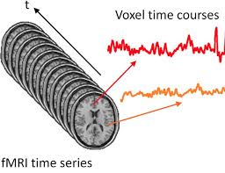
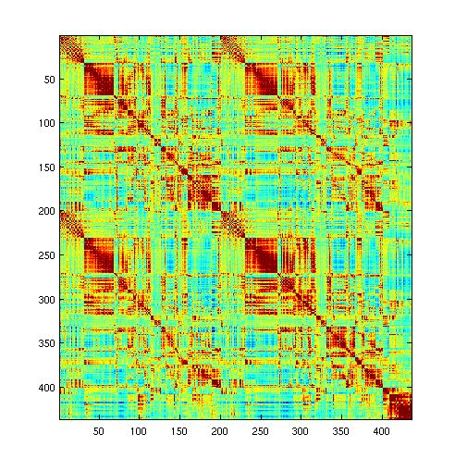
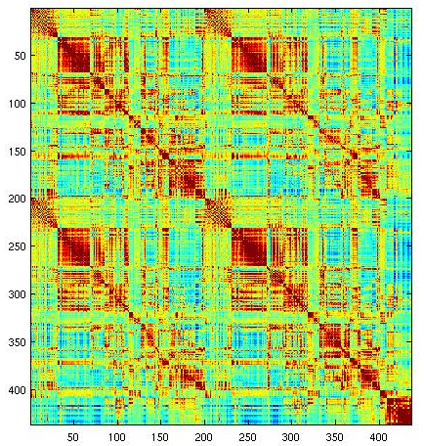
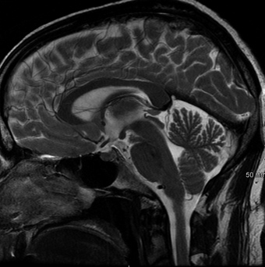
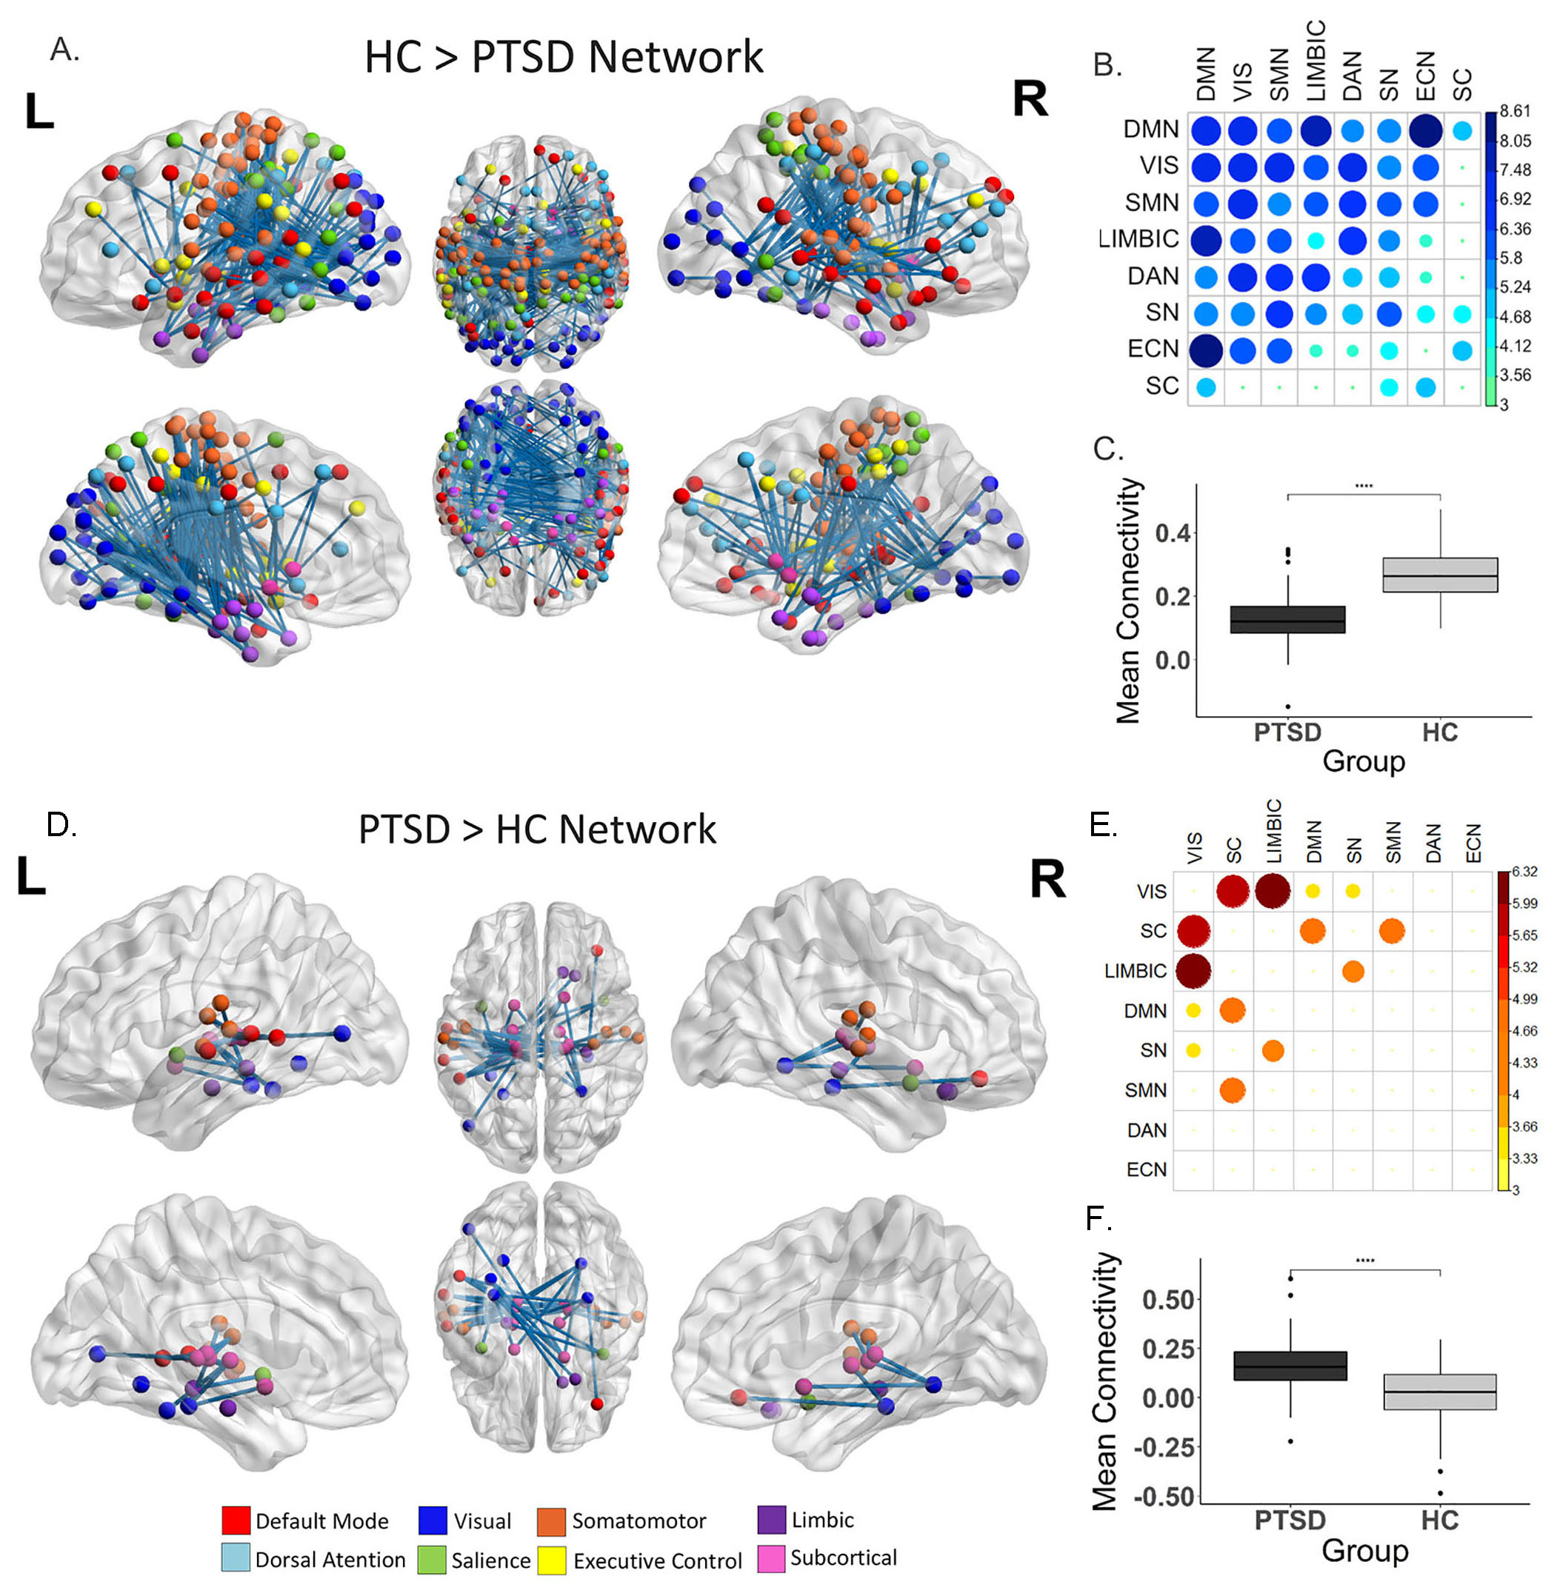
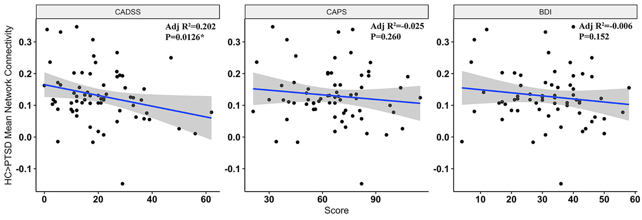
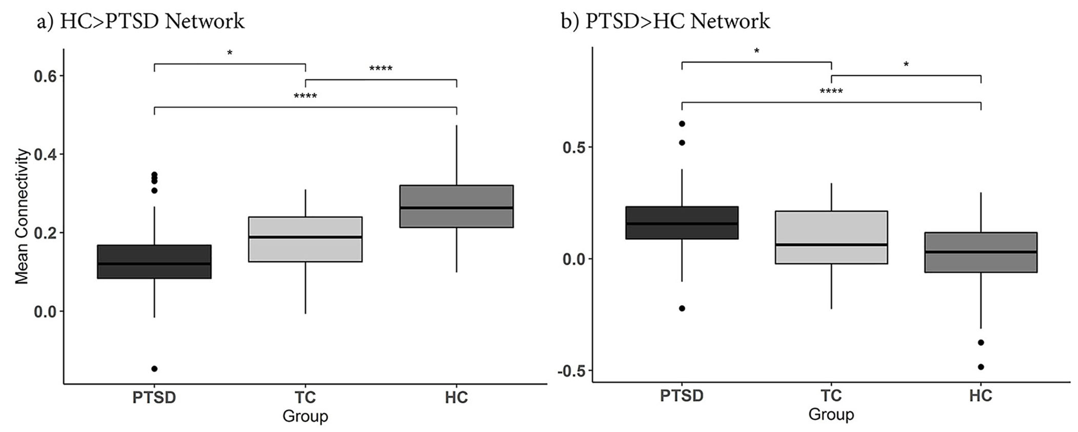




The Functional Connectome in Posttraumatic Stress Disorder
Isabella A. Breukelaar^{1,2}, Richard A. Bryant, PhD^{1,2} & Mayuresh S. Korgaonkar^{1,3,4}
1 Brain Dynamics Centre, Westmead Institute for Medical Research, University of Sydney, Westmead, NSW, Australia
2 School of Psychology, University of New South Wales, Sydney, Australia
3 Discipline of Psychiatry, Sydney Medical School, Westmead, NSW, Australia
4 School of Health Sciences, Faculty of Medicine and Health, The University of Sydney, Sydney, NSW, Australia.
BACKGROUND
What is the functional connectome?
Post-traumatic stress disorder(PTSD) is a group of stress reactions that can develop after experiencing a single or ongoing trauma and persist for an extended period
Characterized by increased fear, anxiety, arousal, sadness and/or numbness and dysphoria
Brain correlates of this disorder are unknown
Previous functional magnetic resonance imaging studies have captured differences in activity or connectivity in specific regions, but are yet to take a brain-wide approach
All the connections in the brain
Based on the idea that the brain is an interconnected whole but functionally organized into a series of networks
Specific patterns of connectivity within and between these networks are reflective of normal brain functioning but it is whole system that is important
Why do we care about this in PTSD?
  Help us understand the brain-basis of this disorder
  Help us understand if specific neural alterations relate to clinical measures or outcomes
  Effected regions and connections could guide development of treatment
  A replicable neural signature of a disorder could be used as a diagnostic tool
Aim to characterize differences in whole-brain connectivity in PTSD compared to health controls
METHODS
METHODS
METHODS
1. Participant Recruitment
2. Functional Magnetic Resonance Imaging (fMRI) scan
3. Whole-brain Functional Connectivity
4. Network Based Statistics Compares Between Groups
67 PTSD Patients
71 Healthy Controls
PTSD
vs.
HC
Participants recruited through Western Sydney Health District and matched on age and gender
Included based on clinical interview with a psychologist
Participants completed “functional” MRI scan at Westmead Hospital, that captures brain activity during certain tasks and at rest
The pattern of activity of each region or “voxel” in the brain is correlated with the pattern of activity of every other region to give a measure of connectivity
Correlation matrices capturing the patterns of whole-bran functional connectivity between regions are tested for differences between healthy and PTSD groups
RESULTS - EXTENSIVE ALTERATIONS IN WHOLE-BRAIN FC IN PTSD
RESULTS – CORRELATION WITH CLINICAL SYMPTOMS
1. Extensive decreases in functional connectivity in PTSD relative to controls throughout all of the higher-order cortical intrinsic connectivity networks that are responsible for controlling your attention and perception of the environment, mimicking the widespread synaptic loss seen in neurobiological models of chronic stress
Mean functional connectivity of the altered network was associated with dissociative symptoms-where you feel disconnected from both your external and sometimes internal world. This is thought to be one of the coping mechanisms that develops following trauma.
Figure 2. Correlation between PTSD network connectivity and BDI, CADSS and CAPS, controlling for age and sex. Lower dissociation score is associated with greater connectivity in HC>PTSD network only. PTSD – Posttraumatic Stress Disorder, BDI – Beck’s Depression Inventory, CADSS – Clinician Administered Dissociative States Scale, CAPS – Clinician Administered PTSD Scale
2. Increased in connectivity in PTSD of subcortical regions, including thalamic and limbic region connections to sensory and default-mode regions, that are responsible for arousal and emotion regulation
RESULTS – INTERMEDIATE CONNECTIVITY IN TRAUMA-EXPOSED HEALTHY CONTROLS
In an additional group of 30 resilient trauma-exposed controls connectivity was intermediate to PTSD and HC. This suggests alterations in the functional connectome in response to trauma exposure could occur on a sliding scale from resilient individuals to clinical manifestations as PTSD.
Figure 3. Comparison between TC, HC and PTSD connectivity in significant networks. Connectivity for significant networks was extracted from TC subgroup and compared post-hoc with HC and PTSD. One-way ANOVA showed all three groups to have significantly difference connectivity for both networks (p<0.001). Post-hoc tests found that TC participants mean connectivity values were in between and significantly difference from HC and PTSD groups for both networks. For the HC > PTSD Networks in a) PTSD<TC: p=0.0366 & HC>TC: p<0.001. For the PTSD>HC Network in b) PTSD>TC: p=0.038 & HC<TC: p=0.046). PTSD – Posttraumatic Stress Disorder, TC – Trauma-exposed Control, HC – Healthy Control. Significance levels are denoted as **** for p<0.001 and * for p<0.05.
Figure 1. Differences in connectivity in PTSD compared to HC identified with network-based statistics. For HC>PTSD, a network comprised of 203 regions and 420 edges (connections) was identified (p<0.001, FWE-corrected) (A-C). For PTSD>HC a network comprised of 34 regions and 50 edges (connections) was identified (D-F). A & D) all significant nodes and edges of HC>PTSD subnetwork visualized on the surface of the brain (created using BrainNet viewer) B & E) a heatmap of the mean t-statistic of significantly different connections within and between the eight primary functional networks. Larger circle size and darker colour represent greater mean t-statistic of connections (larger difference in HC and PTSD connectivity). Networks are ordered based on their overall contribution to the difference in connectivity between PTSD and HC. C & F) Shows the difference in mean connectivity across all significant regions between groups. PTSD – Posttraumatic Stress Disorder, HC – Healthy Controls.
Summary
Wide-spread alterations in the functional connectome in PTSD
Hypoconnectivity throughout cortical networks and hyperconnectivity between sub-cortical and limbic regions and other cortical networks
This could partly reflect an imbalance of inputs/outputs from subcortical and limbic regions – responsible for arousal levels and emotional responses, relative to control and regulatory networks & contribute to the maintenance of a dissociative state and other PTSD symptoms
WestmeadInst
WestmeadInst
The Westmead Institute for Medical Research

